Slide 1





Automated Tools
For System Analysis and Design

Slide 2
Group Members
01
02
03
04
05
Nguyễn Thị Ngọc Ánh
1801040015
Trịnh Quang Huy
1801040106
Nguyễn Thị Ngà
1801040159
Nguyễn Thị Thảo
1801040209
Nguyễn Thu Trang
1801040226

Slide 3


PART 1
Introduction

Slide 4


CASE
Computer-aided Software Engineering
Automated software tools used by systems
analysts to develop information systems
Used to support or automate activities throughout the systems development life cycle (SDLC)
Increase productivity
Improve overall quality of systems
Notes:
https://en.wikipedia.org/wiki/Computer-aided_software_engineering

Slide 5
Categories of CASE Products
Reverse engineering:
an artificial object reveal designs, architecture,
code, extract knowledge from the object.
deconstructed
Reengineering:
redesigning jobs, careers, processes
enhance quality, service, speed.
Notes:
https://searchsoftwarequality.techtarget.com/definition/reverse-engineering
https://en.wikipedia.org/wiki/Reverse_engineering
https://vietnambiz.vn/tai-kien-thiet-reengineering-la-gi-dac-trung-va-lien-he-20191012022307932.htm

Slide 6


PART 2
The Use of CASE in Organizations

Slide 7
Improve quality of systems developed
Increase speed of development and design
Improve testing process through automated checking
Improve quality and completeness of documentation
Improve project management
Simply program maintenance
Promote reusability
Improve software portability

Slide 8

CASE and System Quality
Majority of organizations adopt CASE to improve speed and quality of systems development projects.
Widespread deployment has been slower than expected.
Several factors that inhibit widespread deployment

Slide 9

Cost
CASE tools one systems analyst
Return on Investment
Biggest benefits of CASE come in late stages of SDLC
Productivity Bottlenecks
Difficulty in providing tools for all states of SDLC
$5,000 - $15,000

Slide 10

The Outlook for CASE
Functionality is increasing
Cost is decreasing.
Reverse Engineering Tools
Automated tools that
read program source
code as input and
create graphical and
textual representations of
program design-level information.

Slide 11

PART 3
Components of CASE

Slide 12

Classic CASE Tools
Real CASE Tools
Notes:
Must distinguish between ‘classic’ case tools and ‘real’ case tools:
+ Classic CASE tools: interactive debuggers. Compilers, project progress control systems
+ Real CASE tools: support several phases of development

Slide 13
Components of CASE
Upper CASE
Lower CASE
Cross life-cycle CASE
Notes:
There are several components are based on their usage in different stages of the software development life cycle.
Upper CASE tools support analysis and design
Lower CASE tool refer to the location in these phases in the Waterfall Model
Cross life-cycle CASE or Integrated CASE tools: combine both upper and lower, support analysis, design, and coding Central Repository: A central repository is required by the tools to serve as a common source of integrated and consistent information.

Slide 14
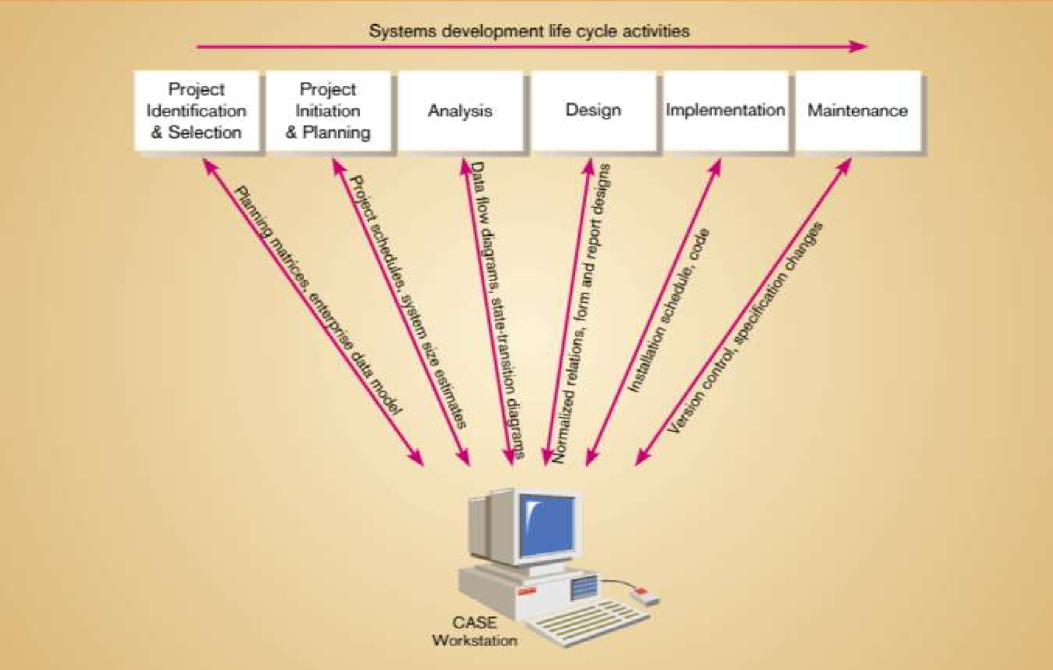
CASE Supports
Notes:
Software tools designed to support activities of system development cycle

Slide 15
PART 4
CASE Tools

Slide 16
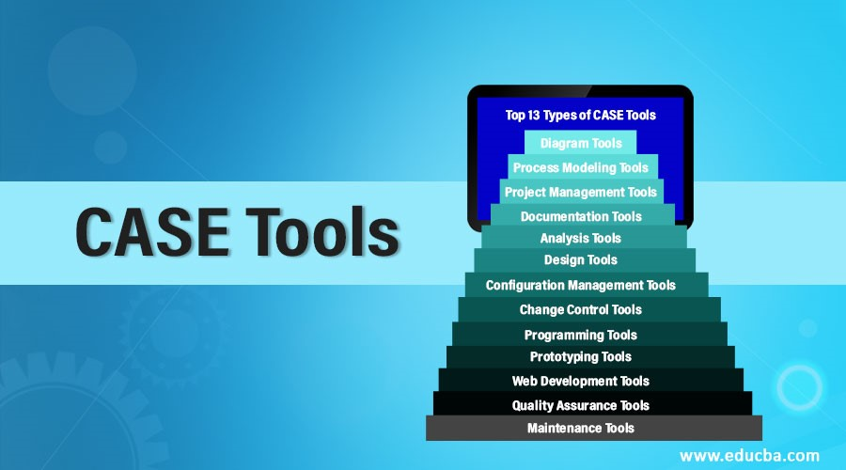
Notes:
Software developers always looking for such CASE tools that help them in many different ways during different development stages of software
They can understand the software and prepare a good end product that efficiently fulfill the user requirements
CASE tools provide the ways that can fulfill the requirements of software developers
These tools provide computerized setting to software developers to analyze a problem and then design its system model

Slide 17
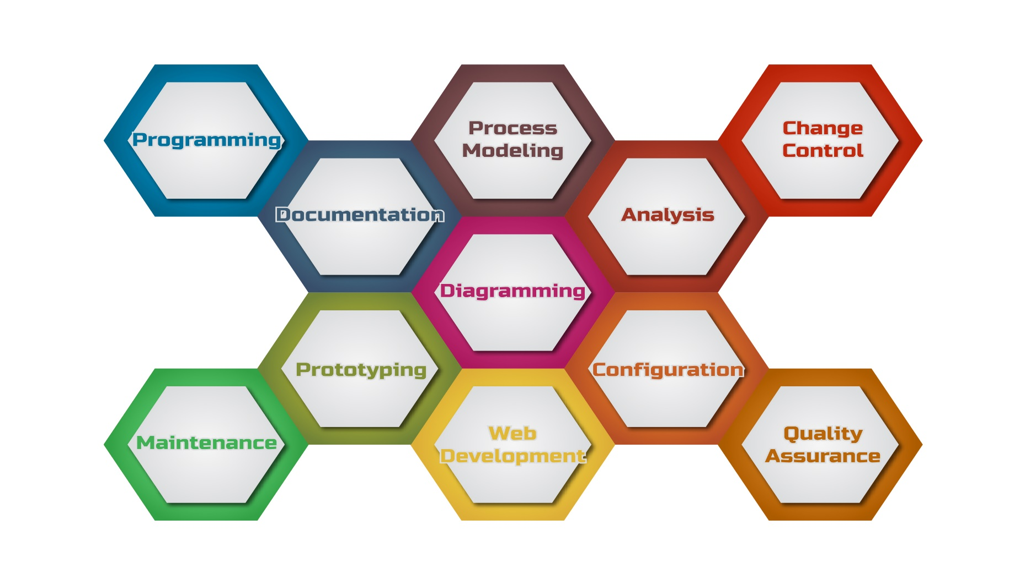
Notes:
Diagramming tools– graphical representation of system components, data and control flow among various software components;
Process modeling tools – create a software process model used to develop the software;
Project management tools – project planning, cost and effort estimation, project scheduling and resource planning.
Documentation tools – generate detailed documents for technical users and end-users describing the function and how-to of the system such as user manual.
Analysis tools – gather requirements, automatically check for inaccuracy and data redundancies.
Design tools – design the block structure of the software, then divide it into modules, provide the details for each module and interconnections among modules.
Configuration management tools – version and revision management, change control management through automatic tracking, version management, and release management.
Change control tools – deal with changes made to the software, automate change tracking, file management, code management an enforce organization change policy.
Programming tools – providing comprehensive aid in building a software product and include features for simulation and testing.
Prototyping tools – provides initial look and feel of the product and simulates a few aspects of the actual product. Also, they help us build rapid prototypes based on existing information.
Web development tools – assist in designing web pages and all their consisting elements, like forms, text, script, graphics.
Quality assurance tools – monitoring the engineering process and methods, in order to ensure conformance of quality as per organization standards.
Maintenance tools – show modifications in the software product after it goes into production. Therefore, automatic logging, error reporting techniques, or automatic error ticket generation.

Slide 18
CASE Form & Report Generator Tools
Two Purposes:
Create, modify and test prototypes of computer display forms and reports
Identify which data items to display or collect for each form or report

Slide 19
Difference between CASE-Based Systems Development and Traditional Systems Development
PART 5

Slide 20
Weaknesses of Traditional Systems
Development
No support
for integration of
documents
Documentation after coding
Out-of-date documentation

Slide 21
Traditional Systems Development
CASE-Based Systems Development
Emphasis
Type
Coding
Documentation
Task
Maintain

Slide 22
THANK
YOU

